Slide 1
Web Scarfing using Java
Yashwanth Yashz

Slide 2
Web Scarfing
Web Scarfing refers to the extraction of data from a website. This information is collected and then exported into a format that is more useful for the user. Be it a spreadsheet or an API.
Data displayed by most websites can only be viewed using a web browser. They do not offer the functionality to save a copy of this data for personal use. The only option then is to manually copy and paste the data - a very tedious job which can take many hours or sometimes days to complete. Web Scarfing is the technique of automating this process, so that instead of manually copying the data from websites, the Web Scarfing Java Code will perform the same task within a fraction of the time.

Slide 3
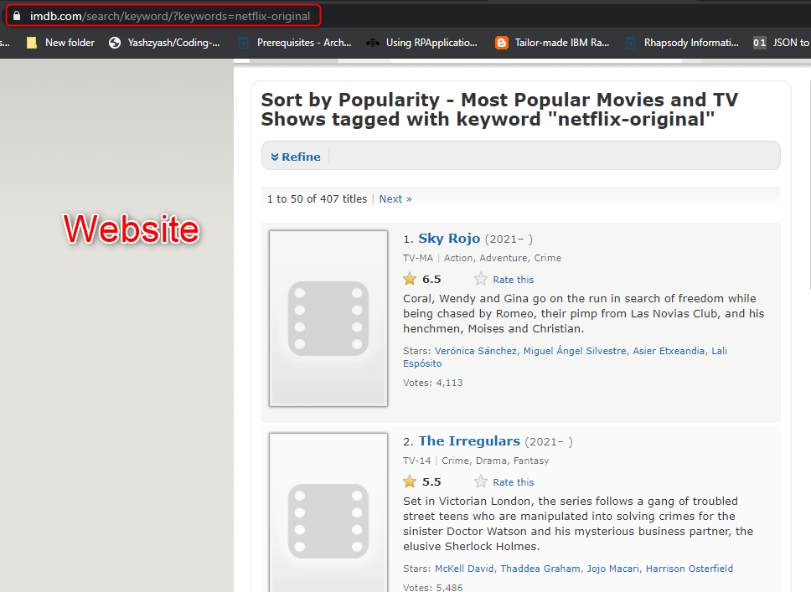
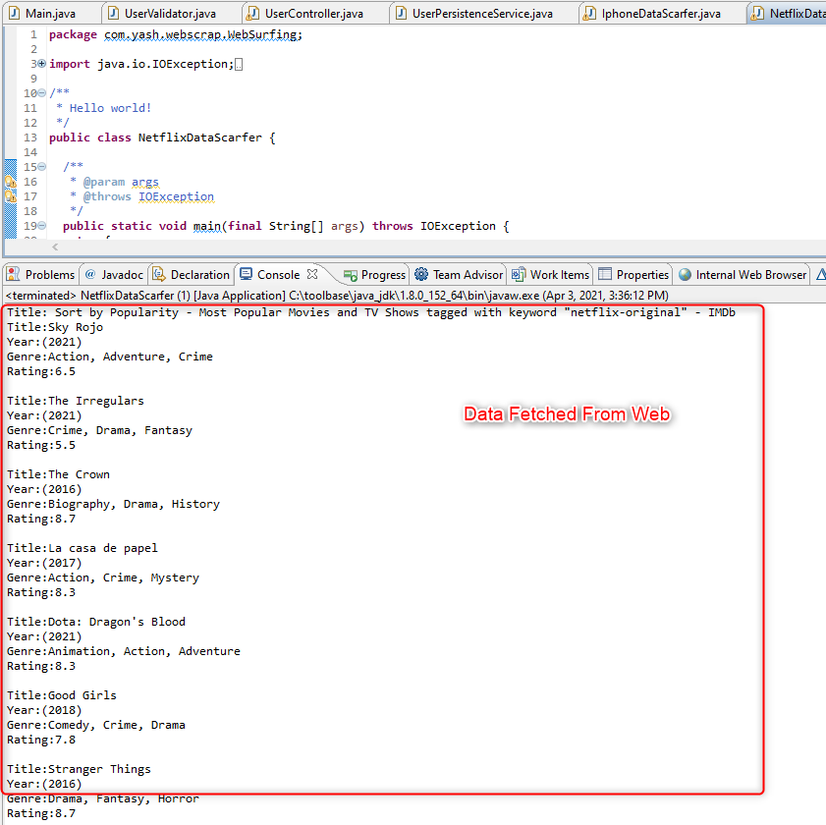
Web Scarfing from IMDB – Netflix Data

Slide 4

Thank You

